Slide 1




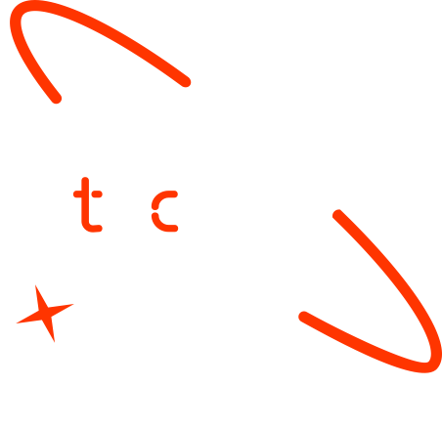

A new generation
of tech specialists

Slide 2
Trash Classifier
(Group – 5)

Slide 3
Background & Objective
Proper waste segregation is essential for environmental sustainability, but manual sorting is time-consuming and error-prone
Develop a web-based Trash Classifier that automatically identifies recyclable and non-recyclable items using images.

Slide 4
SDG Relation
SDG 11: Sustainable Cities and Communities → Reduce landfill waste, promote recycling.
SDG 12: Responsible Consumption and Production → Encourage proper disposal of waste.

Slide 5
Project Element
A lightweight AI model that classifies trash images as Plastic, Paper, or Food Waste using Teachable Machine.
Helps users quickly identify recyclable vs non-recyclable waste.

Slide 6
RoadMap
Collect sample trash images for each class (Plastic, Paper, Food)
Train Teachable Machine image model
Export model as TensorFlow/Keras (.zip)
Prepare Streamlit app for image upload and prediction
Test the app locally

Slide 7
Project Development
Define Problem: Automate trash classification to improve recycling and waste management.
Collect Dataset: Gather images for classes like Plastic, Paper, and Food Waste.
Train Model: Use Teachable Machine to train an image classification model.
Build App: Create a Streamlit interface for uploading images and showing predictions.

Slide 8
Project Cost
Hardware - Laptop
Software - Free (Python, Streamlit, Teachable Machine, TensorFlow)
Dataset - Free (use open-source images or take your own photos)
Miscellaneous - Internet connection

Slide 9
Conclusion and Futurework
Conclusion - The Trash Classifier accurately identifies recyclable and non-recyclable waste using AI.
It demonstrates a simple, fast, and accessible solution for promoting sustainability.
Future Work - Expand the model to include more trash categories for better accuracy.
Integrate with mobile apps or IoT devices for real-time trash sorting and guidance.

Slide 10

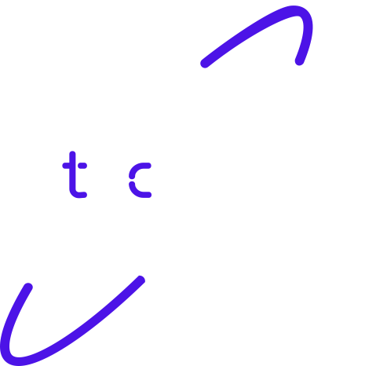
Thank you!

